Slide 1
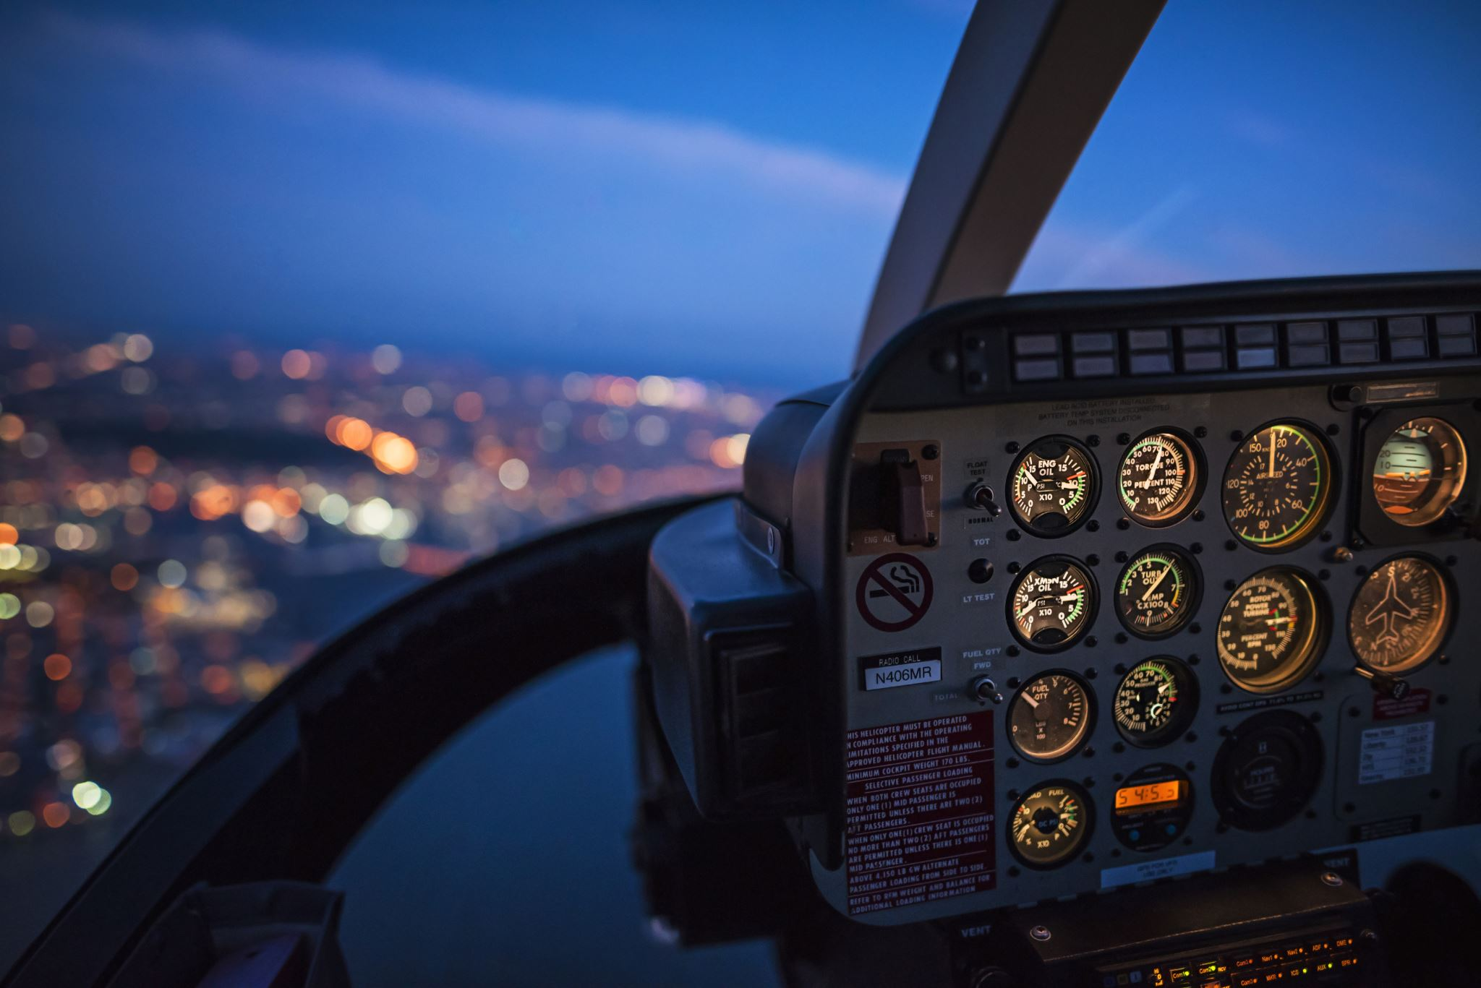

Time: The Final Frontier
“That is if you want to predict demand or estimate the arrival of For Hire Vehicles!”
Presented by:
Morgan Raska, Vinesh Therattil & Chris Nosky

Slide 2

Objective/Problem Statement
To predict daily demand of FHV vehicles on given month in New York City which would help service providers to maintain adequate fleet of vehicles.
To predict Ride durations, this will help in demand planning but more importantly it will help customers identify best times to book a ride.
To predict whether the ride share service will be provided by Uber based on variables provided.

Slide 3
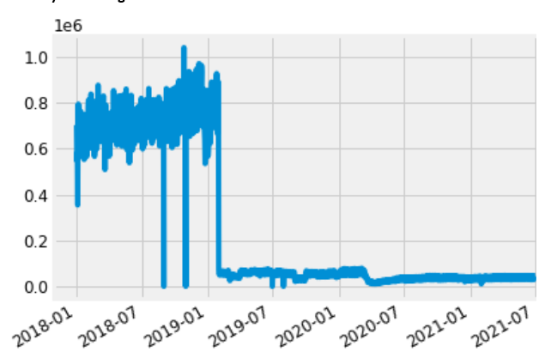
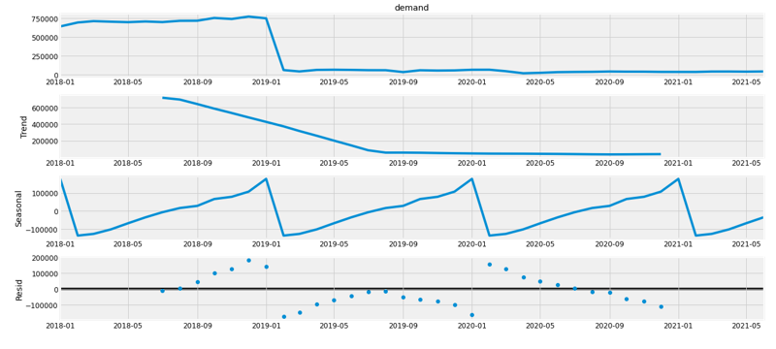
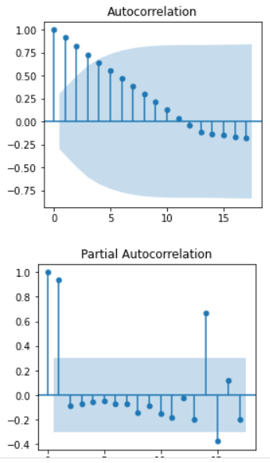
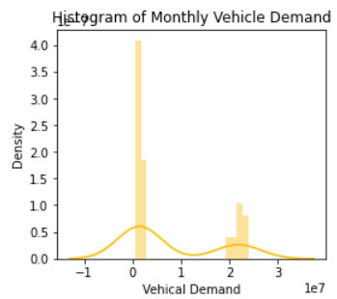
Time Series Decomposition – Trend, Seasonality and Noise
Data Preparation and Exploratory Data Analysis
ACF and PCF
Is distribution Normal ?
Is Timeseries Stationary or Non-Stationary ?

Slide 4
Moving Average – MA
Auto regression – AR
Auto Regression Incremental Moving Average – ARIMA
Seasonal Auto Regression Incremental Moving Average – SARIMA
Seasonal Auto Regression Incremental Moving Average with exogenous variable– SARIMAX
VAR, VARIMA, VARIMAX – Multivariate analysis with multiple time series
Prophet – Facebooks open-sourced model
DATA MODEL – Model selection Available to Solve Timeseries Problems

Slide 5
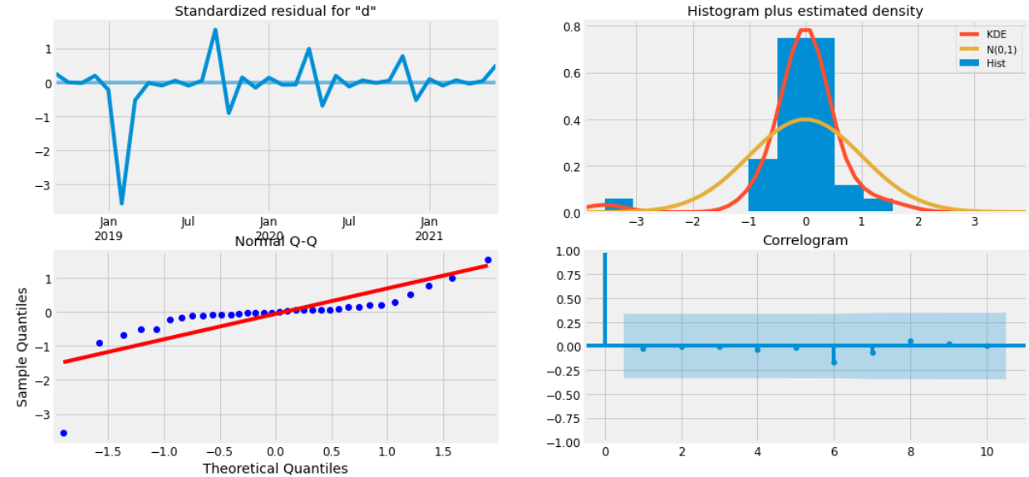
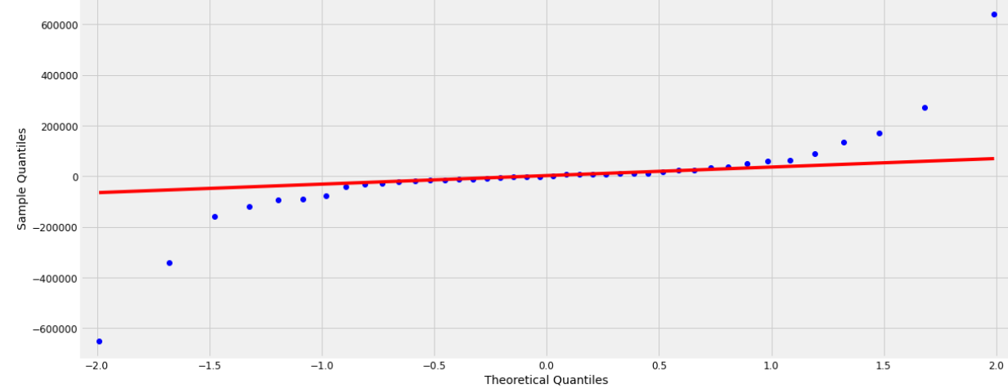
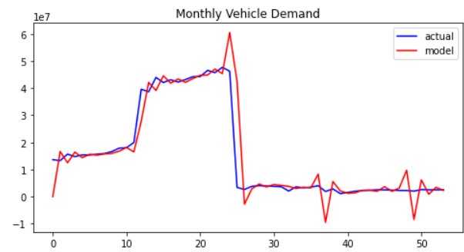
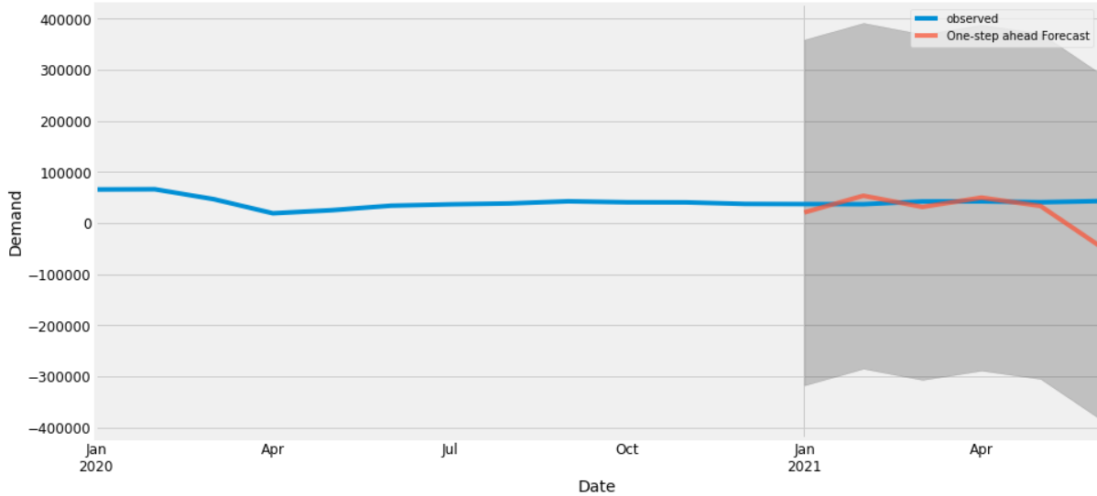
diagnostics
Residue qq-plot
Data Model - SARIMa Evaluation using Diagnostic, Residue QQ-PLOTS, Forecast
actual
Vs Predictions
forecasting

Slide 6
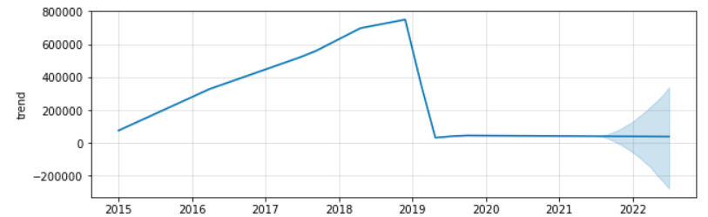
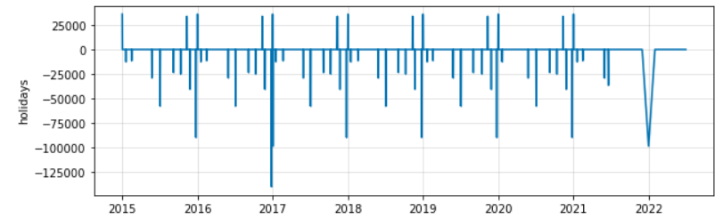
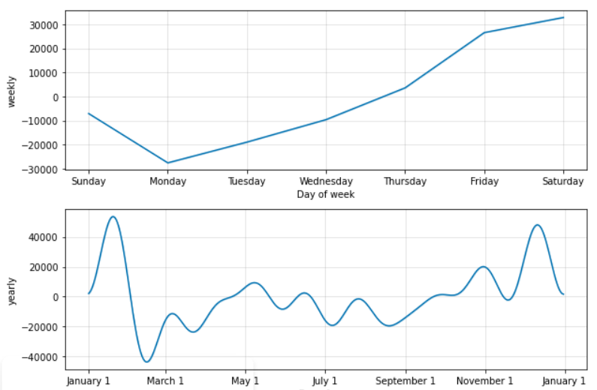
trend
HOLIDAY TRENDS
Data Model – PROPHET COMPONENTS
Weekly AND YEARLY TRENDS

Slide 7
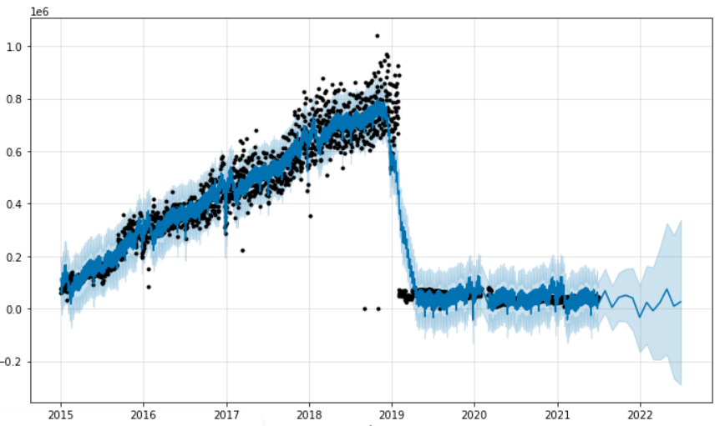
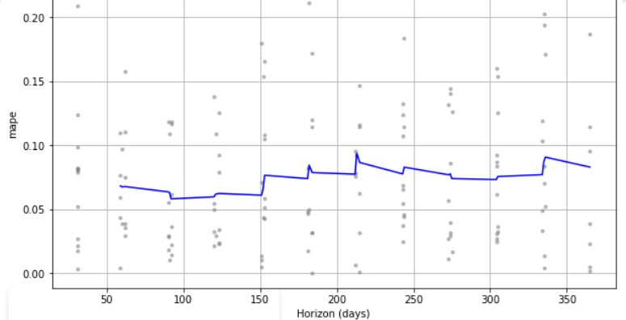
Prophet – blue forecast on actual trend line
Data Model - prophet Evaluation using PLOTTING FORECAST AND MAPE PERFORMANCE METRICS
Performance – metrics

Slide 8
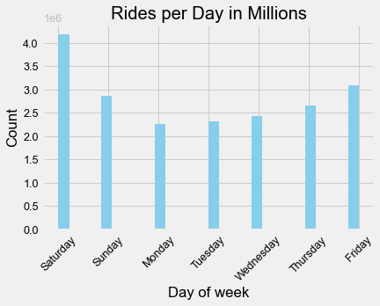
Trip Duration
To get to an estimated time of arrival or trip duration we needed to create a new feature.
The dataset came initially with both pickup and drop off features as a date time.
To make the most use of the datetime values they were parsed and split by year, month, day and hour of the day.
After feature engineering, unnecessary features were dropped.

Slide 9
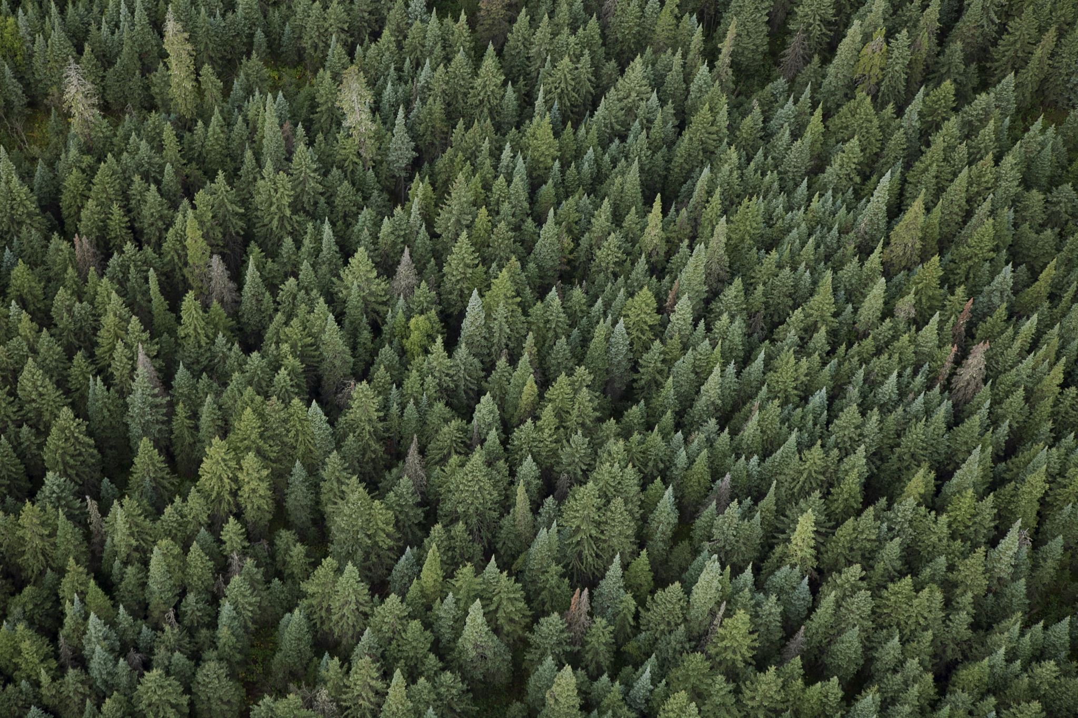
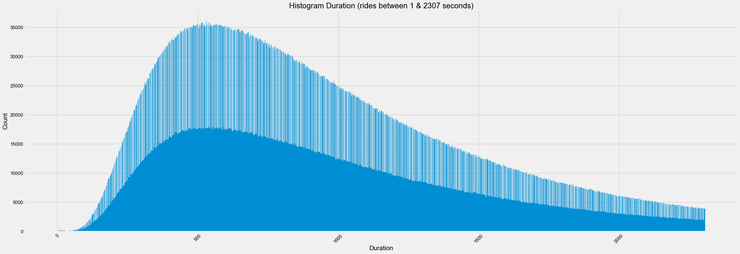
Random Forest Regression
One model that has been explored has been a random forest regression model.
But before getting into the model, we needed to deal with a tiny elephant in the room.… or data rather.
When examining the data, we found rides with durations of zero seconds all the way up to 80000 seconds (around 22 hours)
Ultimately, the decision was made to utilize only the rides that were at least 60 seconds and no more than 2700 seconds (45 minutes)

Slide 10
Random Forest Regression – The sequel
This model was explored initially because it handled biased data well.
After splitting the data into training / test / validation sets the real fun began.
Surprisingly, without any tuning the model came back with an impressive 63% accuracy, is that good enough? We shall see….

Slide 11
Data Preparation on Monthly Record of FHV data from Taxi and Limousine Commission
Clean
Combine
Column
Feature Engineering of Date Fields.
Combining Monthly data set into single file for analysis.
Separation of providers into additional columns (Uber, Lyft, Juno, VIA)

Slide 12
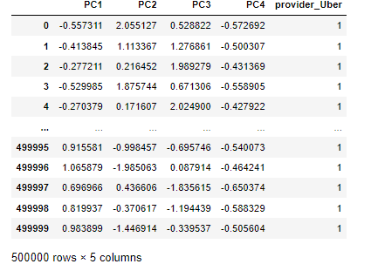
Exploratory Data Analysis – Principal Component Analysis
Feature Selection – The use of 4 principal components should be enough to represent the data in the monthly data set.
Select variables will be encoded

Slide 13
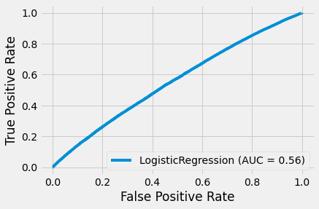
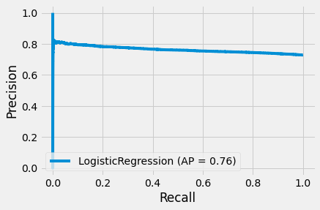
Logistic Regression- Uber Provider
The value of .56 AUC shows that about 40% of the predictions could be a false positive. In the Precision Recall curve it shows the threshold with low recall, the precision is correspondingly high, and at very high recall, the precision begins to drop. This tells calculates that this logistic regression model has a precision of about .75.
AP
AUC

Slide 14
Logistic Regression- Uber Provider Conclusion
Logistic Regression model can predict (using the variables provided) whether or not Uber will be the ride share service in that location of New York accurately approximately ¾ of the time used.
This model could be used under the discretion of the individual desiring a ride share service. If they are aware of the probability of whether the Uber service will or will not be provided they could plan accordingly (i.e. having the necessary application at their disposal to obtain a ride share service).
This model could be used for those providing the Uber ride share service, to identify areas that have less Uber drivers available. Thus providing a service where there is more of a probability that their services are needed.

Slide 15
???

